Slide 1
Chatbot learning on reddit
Prepared by:Sultan Kabi
Checked by:Aleksandr Pak

Slide 2
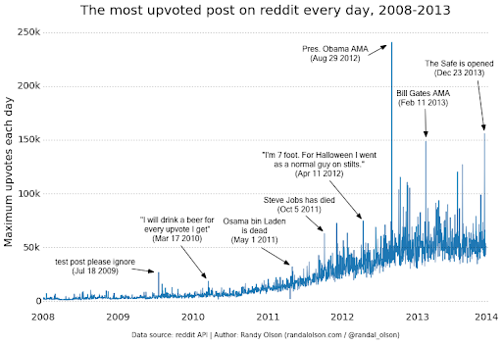
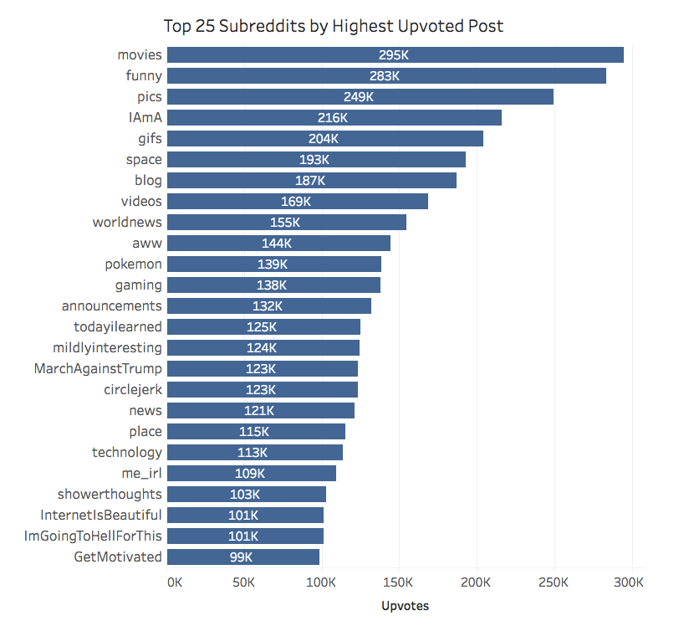
Purpose
The main purpose of the chatbot is to show relevant posts from reddit(the most upvoted posts).

Slide 3
Structuring and clearing data
First, we will store data in a SQLite database, so we will need to import SQLite3 so that we can insert data into the database using SQLite queries.
We will also need to import JSON to load the data rows and import the date and time into the log and track how long it takes to process the data.
import sqlite3
import json # is used to load strings from data
from datetime import datetime # used for registration
Next, let's create some variables and also structure the code so that we can create one SQL interaction that executes all of the code at the same time, rather than one at a time.
# to create a large transaction to commit all rows at the same time, rather than one at a time
timeframe = '2015-05'
sql_transaction = []
Now let's start connecting to data. This is the part that caused me minor problems and was not explained in the manual. Now that we have data, let's look at one line of JSON data: {"author": "Arve", "link_id": "t3_5yba3", "score": 0, "body": "Can we drop this the words \" Ajax \ "now? \ R \ n \ r \ n (But yes, this _is_ is much better)", "score_hidden": false, "author_flair_text": null, "gilded": 0, "subreddit": "reddit. com "," edited ": false," author_flair_css_class ": null," retrieved_on ": 1427426409," name ":" t1_c0299ap "," created_utc ":" 1192450643 "," parent_id ":" t1_c02999p "," inconsistency ": 0 , ups: 0, outstanding: null, id: c0299ap, subreddit_id: t5_6, down: 0, archived: true} The most important fields we will consider are parent_id, comment_id, body, name and score.

Slide 4
Let's write SQL inserts
Here we will define SQLite inserts that will significantly add or modify information in the database we are creating. We will define a function called sql_insert_replace_comment that will take the main comment fields and replace the comment if the comment scores higher than the previous comment.
def sql_insert_replace_comment (commentid, parentid, parent, comment, subreddit, time, score):
try:
sql = "" "UPDATE parent_reply SET parent_id =?, comment_id =?, parent =?, comment =?, subreddit =?, unix =?, score =? WHERE parent_id = ?;" "". format (parentid, commentid, parent, comment, subreddit, int (time), score, parentid)
transaction_bldr (sql)
except Exception as e:
print ('s0 insertion', str (e))
Then we'll write an insert request that inserts a new row with parent_id and parent body if the comment has a parent. This will provide the pair we need to train the chatbot.
def sql_insert_has_parent (commentid, parentid, parent, comment, subreddit, time, score):
try:
sql = "" "INSERT INTO parent_reply (parent_id, comment_id, parent, comment, subreddit, unix, score) VALUES (" {} "," {} "," {} "," {} "," {} ", {}, {}); "" ". format (parentid, commentid, parent, comment, subreddit, int (time), score)
transaction_bldr (sql)
except Exception as e:
print ('s0 insertion', str (e))

Slide 5
Create paired strings
We will now sort our paired rows using the insert queries and data cleansing functions we wrote above. First, we'll start with a check that ensures that the table is always created regardless of whether there is data. We'll also create variables that count the row we're currently in and the number of paired rows that are parent-child pairs.
if __name__ == '__main__':
create_ table ( )
row_counter = 0
paired_rows = 0
Using our data, let's create our data table by including our functions. Assign names for them such as parent_id = string ["parent_id"] with open ("../ data / RC _ {}". format (timeframe), buffering = 1000) as f:
for row in f:
row_counter += 1
row = json.loads(row)
parent_id = row['parent_id']
body = format_data(row['body'])
created_utc = row['created_utc']
score = row['score']
comment_id = row['name']
subreddit = row['subreddit']
parent_data = find_parent(parent_id)
Next, let's look at the account. We want to make sure that at least 1 person has seen the comment, so for the sake of safety, let's continue to label this line as a paired line answer, only if the rating is greater than or equal to 2 votes for.
Total lines read: 100000, paired lines: 3221, time: 2021-05-17 15: 14: 33.748595
Total rows read: 200000, paired rows: 8071, time: 2021-05-17 15: 14: 55.342929
Total lines read: 300000, paired lines: 13697, time: 2021-05-17 15: 15: 18.035447
Total lines read: 400000, paired lines: 19723, time: 2021-05-17 15: 15: 40.311376
Total lines read: 500000, paired lines: 25643, time: 2021-05-17 15: 16: 02.045075

Slide 6
Divide data
We will be using data analysis pandas to help us create a dataframe to visualize our data.
import sqlite3
import pandas as pd
from datetime import datetime
Then create labels. The limit label will represent how many rows we will pull each time to show the dataframe in the panda and last_unix will help us buffer through the database.
for timeframe in timeframes:
connection = sqlite3.connect ('../ data / {}. db'.format (timeframe))
c = connection.cursor ()
limit = 5000
last_unix = 0
cur_length = limit
counter = 0
test_done = False
Now let's write a while loop to keep pulling towards the dataframe until we reach the limit displayed in the dataframe. Then when we hit the limit, we put data in the data frame. Since my computer was very slow to create this data frame, it often hung up for so long that I thought it had stopped working. So I decided to add my own print statement to make sure that the code is working correctly. I have included print ('Before, Time: {}'. Format (str (datetime.now ()))) and print ('After, Time: {}'. Format (str (datetime.now ()))) so that you could see how much time passes between each pandas fetch and log the time to see how much time is left for your code to run.

Slide 7
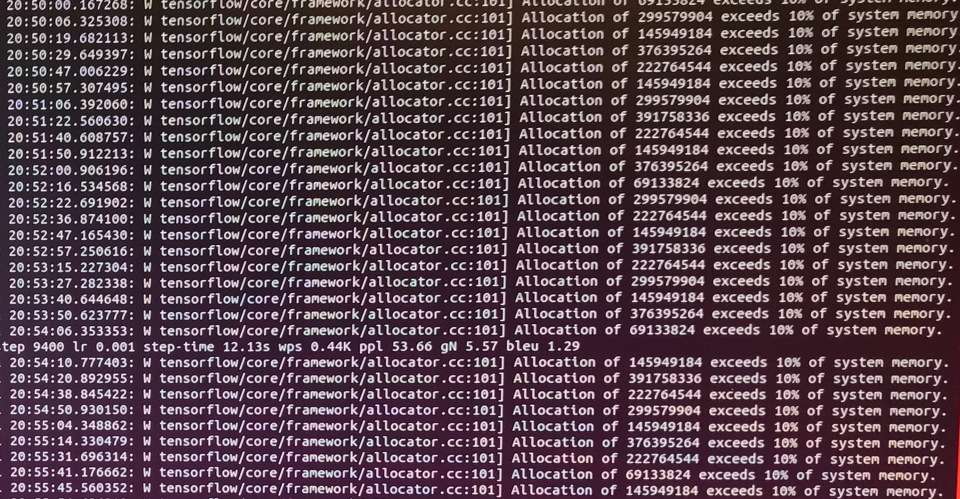
Training with nmt-chatbot
We will use a set of utilities that use the nmt Tensor Flow model called nmt-chatbot, created by sentdex and his friend Daniel Kukiela. nmt-chatbot provides a set of tools to train our chatbot, but it needs the following to train it:
*tenorflow-gpu 1.4.0
*Python 3.6+
*CUDA Toolkit 8.0
*cuDNN 6.1

Slide 8
NMT, the main weapon in the arsenal of machine translation
Unlike other approaches such as statistic-based machine translation and rule-based machine translation, neural machine translation uses a large neural network that uses artificial intelligence to work according to the principles of the human brain.
►NMT is useful in a variety of sectors, especially e-commerce, although provided that various criteria are met that help facilitate the translation process, such as sufficient repetitions, sufficient specialized data available to train the translation engine. , and a sufficiently large amount of text for translation.
►NMT is the latest machine translation method and is said to provide more accurate translations than SMT.
►NMT is based on a model of neural networks in the human brain, with information sent to different "levels" for processing before being output.
►NMT uses deep learning techniques to learn how to translate text based on existing statistical models. It provides faster translations than the statistical method and allows for better quality results.
►NMT can use algorithms to self-study linguistic rules based on statistical models. The biggest advantage of the NMT is its speed and quality.
Many people say that NMT is the way of the future, and this process will undoubtedly continue to expand its capabilities.

Slide 9
Cons of NMT
The disadvantage of NMT is that the phrases in the source text must be very clear and coherent. Every little ambiguity must be factored into the software in advance so that you don't get an answer that no longer makes sense. Neural machine translation faces challenges when faced with highly technical language or the use of rare words. There are various aspects to consider before performing neural machine translation.
►Clarity of the translated text (to avoid ambiguity)
►Training and human judgment when dealing with certain specific sectors (legal, medical, etc.)
► Data privacy management: It is important to know that publicly available translation systems store and store all the data and information they process on their servers. This means that it is difficult or even impossible to guarantee the confidentiality of customer data.
►Creative aspect: the translation system trains what it considers to be the norm and therefore will always produce the translation that, from its point of view, is most appropriate in relation to what it has learned.

Slide 10
Training with ANN
Libraries used:
1. Theano
- numerical computation library very efficient for fast numerical computation based on Numpy syntax
- The GPU is much more powerful than the CPU, since there are many more cores and more floating point calculations are performed per second.
- The GPU is much more specialized for high-intensity computational tasks and parallel computing, just for neural networks.
- When we promote the activation of various neurons in the neural network, thanks to the activation function, which enables parallel computation.
- When errors are passed back to neural networks, which again involves parallel computation.
- GPU is a much better choice for deep neural networks than CPUs - simple neural networks, CPU is enough
- Created by the University of Montreal Machine Learning Group.

Slide 11
2. Tensorflow
- Another numerical computation library that does very fast computations that can be done on your CPU or GPU.
- Google Brain, Apache 2.0 license
- Theano and Tensorflow are mainly used for deep learning research and development.
- Deep learning neural network from scratch, use the above
- Great for inventing new deep learning neural networks, deep learning models, lots of lines of code.
3. Keras
- Wrapper for Theano + Tensorflow
- Awesome library for building deep neural networks in a few lines of code.
- Very powerful deep neural networks in a few lines of code
- based on Theano and Tensorflow
- Sci-kit Learn (machine learning models), Keras (deep learning models)

Slide 12
ANN advantages
►Store information throughout the network: information such as in traditional programming is stored throughout the network, not in a database. The disappearance of several pieces of information in one place does not interfere with the operation of the network.
► Ability to work with incomplete knowledge: after training ANN, data can be output even with incomplete information. The loss of productivity here depends on the importance of the missing information.
► Availability of fault tolerance: Corruption of one or more ANN cells does not prevent it from generating output. This feature makes networks resilient.
► Machine learning capability: Artificial neural networks learn events and make decisions by commenting on similar events.
► Parallel processing capability: Artificial neural networks have numerical power that can perform multiple tasks at the same time.
► Availability of distributed memory: in order for the ANN to learn, it is necessary to define examples and train the network according to the desired result by showing these examples on the network. The success of the network is directly proportional to the instances selected, and if an event cannot be shown to the network in all its aspects, the network may give a false result.

Slide 13
Disadvantages of ANN
► Hardware Dependency: Artificial neural networks require processors with parallel processing power according to their structure. For this reason, the hardware implementation is dependent.
► Unexplained Network Behavior: This is ANN's most important problem. When ANN issues a trial solution, it does not make it clear why or how. This reduces the credibility of the network.
► Determining the correct network structure: There is no specific rule for determining the structure of artificial neural networks. An appropriate network structure is achieved through experience, trial and error.
► Difficulty displaying the problem in the network: ANN can work with numerical information. Problems must be converted to numerical values ​​before they can be submitted to ANN. The rendering engine defined here will have a direct impact on network performance. It depends on the user's ability.
► The duration of the network is unknown: the network is reduced to a certain value, an error in the sample means that training is completed. This value does not give optimal results.
► Gradual damage: the network slows down over time and undergoes relative degradation. The network problem does not go away immediately.

Slide 14
Conclusion
Scientific artificial neural networks, which appeared in the world in the middle of the 20th century, are rapidly developing. These days, we have studied the benefits of artificial neural networks and the problems that arise when using them. It should not be forgotten that the disadvantages of ANNs, which are a growing branch of science, are being eliminated one by one, and their advantages are growing day by day. This means that artificial neural networks will become an integral part of our life, more and more important.
In the chatbot project, learning on reddit, various problems were encountered, starting with various small errors, ending with a time-devouring compilation.
The biggest problem was the long compilation time and the load on the laptop. Also, this problem limited the amount of data to 500MB. And for neural networks, the more information (data), the better it learns.
The design can be improved by adding an attention mechanism that allows the model to focus on the most relevant characteristics of the input sentence during the decoding phase. As mentioned above, we can increase the amount of data in order for the network to learn better. In addition, a bi-directional encoder and a decoder beam-seeking algorithm can be included in the model to improve the quality of responses.

